Slide 1

Online Retail
Analysis
Business Itelligence project
Sabrine Ayadi

Slide 2



Contents
01.
02.
03.
Introduction
Implemented phases
Conclusion

Slide 3
01. Introduction
This project is designed to support a UK-based, registered non-store online retail business by developing a comprehensive, data-driven solution that empowers insightful analysis and facilitates informed decision-making.
It aims to unlock valuable insights into customer purchasing behaviors, product performance,
and sales trends, enabling the business to identify patterns and opportunities across various regions
and time periods.

Slide 4



Business Needs
Decide on which country to open their first store
Identify which products to market more
Identify which gender to target more

Slide 5
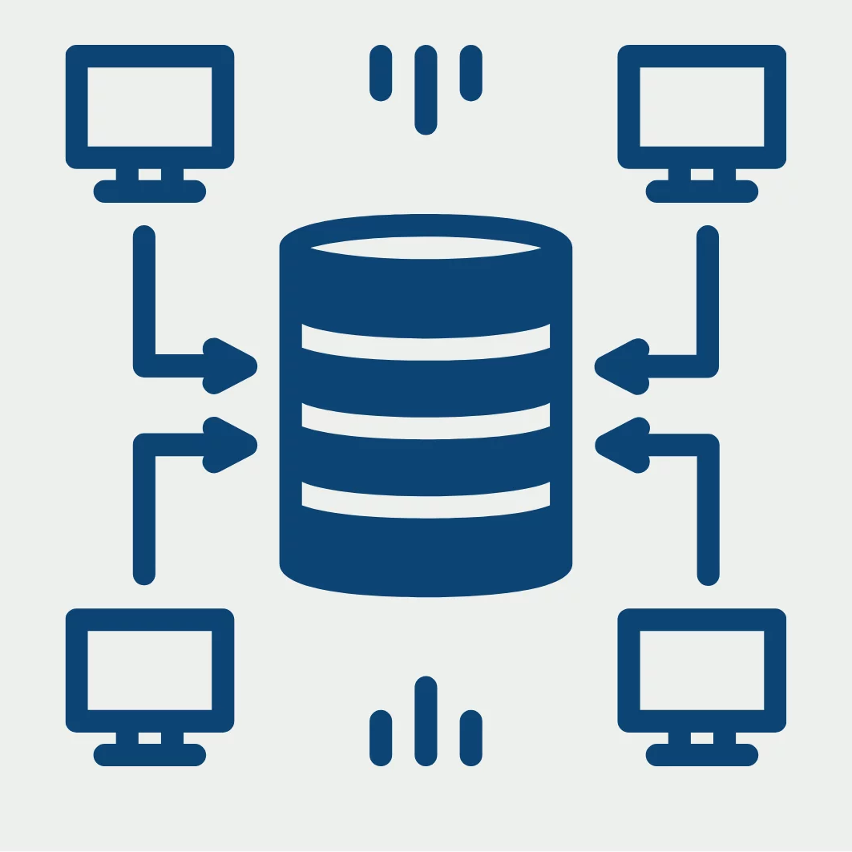
Goals
Data Warehouse Implementation : Create a robust data warehouse that
facilitates efficient storage, retrieval, and analysis of transactional data
Enhanced Decision-Making: Provide actionable insights to stakeholders by analyzing historical sales data.
Performance Monitoring: Track sales performance across various dimensions such as products, customers, and time.

Slide 6
Delivrables
A comprehensive data model
Implementation of an ETL process to populate the data warehouse.
Interactive dashboards using Power BI for visualization.

Slide 7
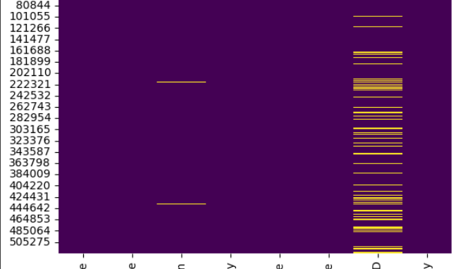
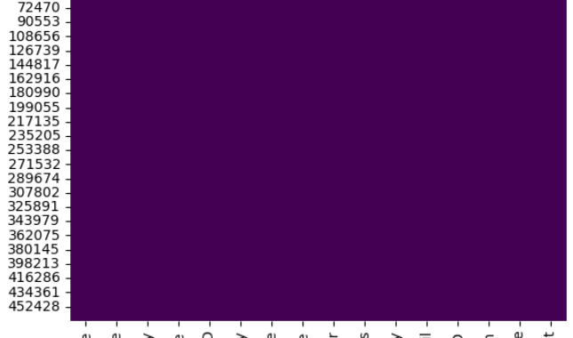
02. Implemented Phases
1. Data collection and Preprocessing
->Collected raw transactional data from two sources.
The sales data was collected from UC Irvine Machine Learning Repository website , it is a huge dataset that contains invoice information such as quantity , product description ,and customer id .
The second source of data that is customer information was synthesized , it contains customer information such as country,
gender , and address.
By inspecting the data with heatmap , we can see a lot of missing data especially in customer ID column . This issue was delt with by filling the missing values with unique ids .

Slide 8
2.ETL process implementation
ETL process was implemented using python on Colab
ETL code
Extract
Transform
Load
The data was extracted from two sources online retail and customer excel file by using read excel function
Several transformations were done on the extracted data such as:
Data Cleaning
Data Joining
Data Splitting
Data Transformation
Data Enrichment
Data Filtering
Load was done manually by downloading the transformed data into a csv file and importing them into the created tables on postgresql

Slide 9
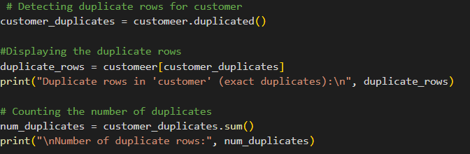
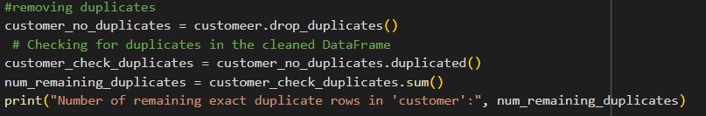
Exemples of transformations
Data Cleaning
Here we detected duplicate rows in customer dataset and deleted them

Slide 10
Exemples of transformations
Data Joining
We joined retail information dataset with customer dataset based on customer ID

Slide 11
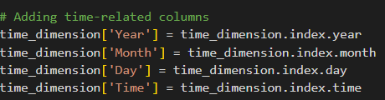
Exemples of transformations
Data Splitting
From a column containing date and time we extracted year , month , day ,and time columns

Slide 12
Exemples of transformations
Data Transformation
Data type convertion
Data derivation

Slide 13
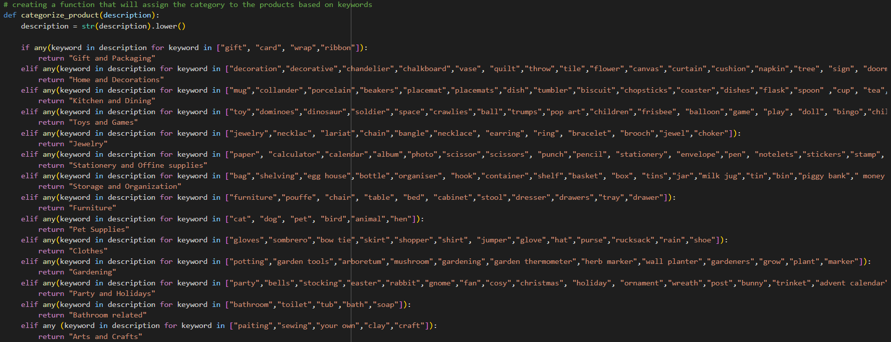
Exemples of transformations
Data Enrichment
In order give more depth to the products we developed a function in order to attribute a category to the product based on keywords

Slide 14

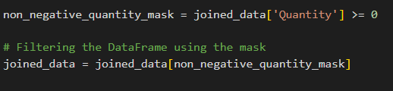
Exemples of transformations
Data Filtering
We filtered the data to keep only positive quantities

Slide 15
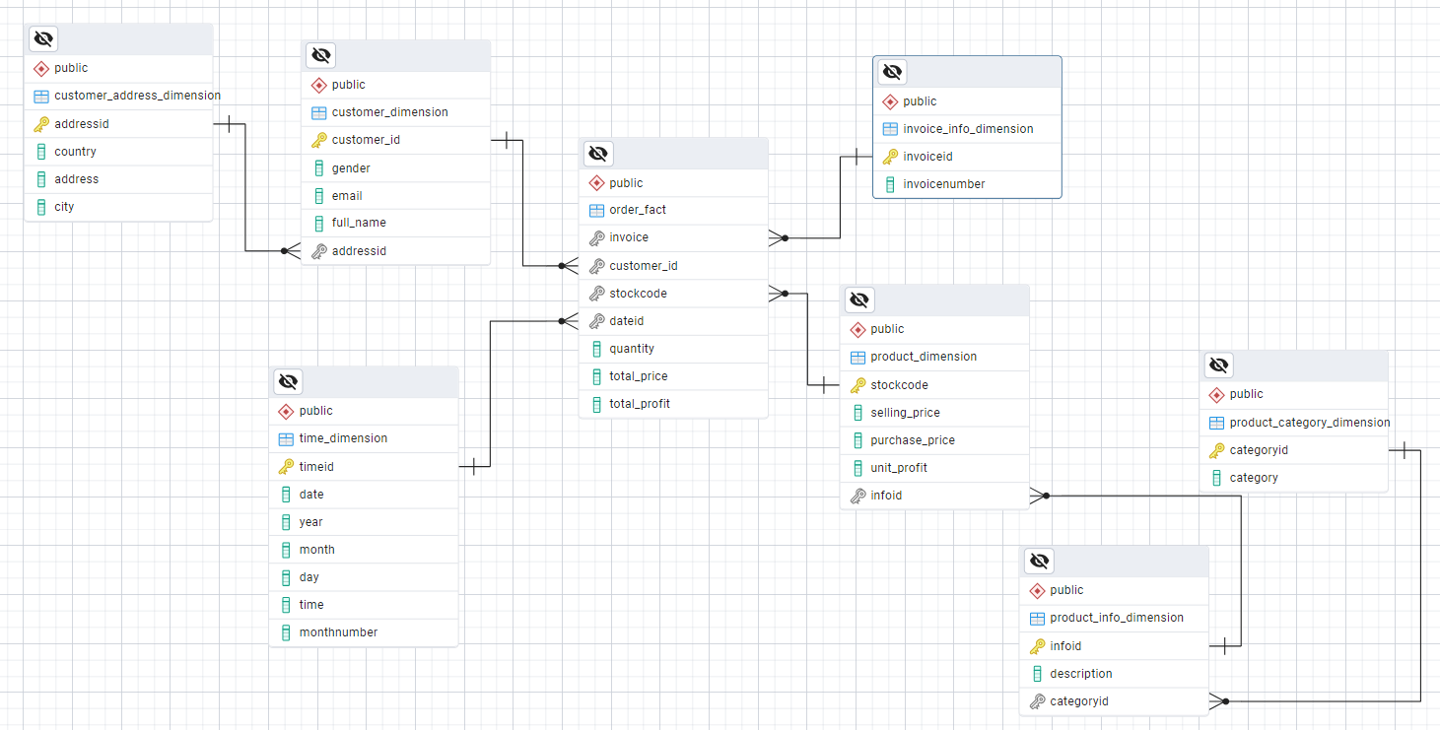
3.Data modeling
The chosen schema is a snowflake schema
The reason behind the choice of this schema is that some dimension tables
can be normalized into several related
table such as customer dimension table
The Snowflake schema consists of :
A central fact table (orderfact)
Dimension tables (cusstomer dim,
customer address dim, time dim,invoice info dim,product dim,product category
dim,product info dim).

Slide 16
4. OLAP implementation
OLAP (Online Analytical Processing) was implemented using Power BI with data sourced from PostgreSQL.The chosen approach was Import Mode, which follows a MLOAP (Multidimensional OLAP)
model by preloading data into Power BI s in-memory engine
This approach leans toward the MOLAP model due to its local data storage, in-memory procesing, and focus on fast query performance.
A copy of the data from the PostgreSQL source is imported into Power BI's in-memory engine.
This creates a local data model within the Power BI file
Power BI then performs analysis and calculations on this local data

Slide 17
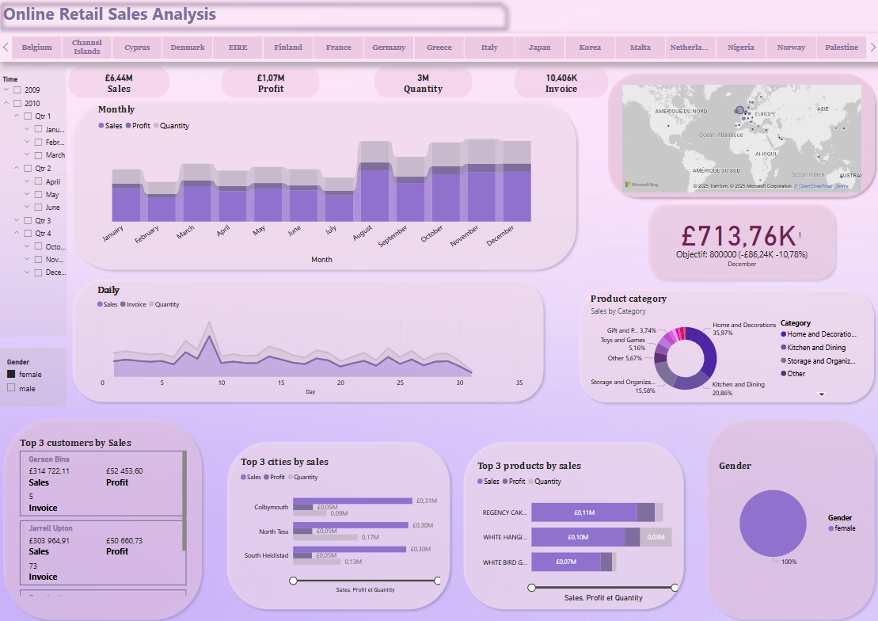
5. Dashboard
The dashboard visualizes key performance indicators such as total sales, top-selling products, and top-buying customers.
We Implemented drill-down capabilities such for time where we can drill-down to months and to days or rollup to year
we implemented filtering capabilities such for gender and country for deeper insights. We can utilize them to dice and slice our cube

Slide 18
Conclusion
Possible Enhancements:
Automating the ETL process for better scheduling and monitoring.
Implementing HOLAP (Hybrid OLAP) for a balance between storage efficiency and query performance.
Enhancing dashboards with predictive analytics using machine learning models.
Expanding the data warehouse to include social media and customer feedback data for
sentiment analysis.

Slide 19
Thank you
for your attention !

